Slide 1
COMP7409 Machine Learning in Trading and Finance
This course provides an introduction to the field of Machine Learning for our students and equips them with the necessary skills to apply it in problem-solving for Trading and Finance.

Slide 2
About this course
Instructor: H.F. Ting
TAs: Lei Li, Lincoln C.M. CHOW
Assessment
One programming assignment (25%)
Group project (40%)
five students per group.
Any topic related to ML in finance and trading is okay. Last semester, most projects are on the topics covered in the course
One presentation
One project report
Final Exam (35%)

Slide 3
Topics to be covered
Eight lectures
Basics of Data Science
Basics of Machine Learning
Financial fraud detection by ML
Financial forecasting by ML
Sentiment Analysis
Trading bot with reinforcement learning
Option pricing with deep learning
Two lectures
Project presentations

Slide 4
Tentative schedule for the coursework
Sep 21 last day to form your project groups (Sep 22 finalize member list of project groups)
Sep 28 submit title of project & name of group leader
Oct 5 release of Assignment 1
Nov 2 due date of Assignment 1
Nov 9 and Nov 16 Project presentation days
Nov 30 due date of project reports (only one report per group)
Note: Each project report must include a section on the workload distribution, and this section must be agreed and signed by all members. Also, we will use Turnitin to scan the reports.

Slide 5

Tentative schedule for the coursework
Sep 21 last day to form your project groups (Sep 22 finalize member list of project groups)
Sep 28 submit title of project & name of group leader
Oct 5 release of Assignment 1
Nov 2 due date of Assignment 1
Nov 9 and Nov 16 Project presentation days
Nov 30 due date of project reports (only one report per group)
Note: Each project report must include a section on the workload distribution, and this section must be agreed and signed by all members. Also, we will use Turnitin to scan the reports.

Slide 6
Data Science and Machine Learning
In the last two decades, more than 20,000 software packages (libraries) for DS and ML have been developed, and everyone can use them freely. For this course, we will use some of these packages to solve our problems in finance and trading.
First question: How to install and use them?

Slide 7
How to use the software packages

Slide 8
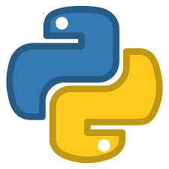

Programming Languages
Python
R
Free & open source
Simple syntax, easy to learn and understand
General-purpose programming language
Has a rich set of libraries and tools designed for data science
Good memory management and high performance
Free & open source
Supports matrix arithmetic, able to handle complex linear algebra
Not a general-purpose programming language (but for statistical programming)
Has many functionalities/libraries/packages for data analysis and visualization but there are many dependencies between libraries
Speed and the amount of memory spent is a problem if code is poorly written
Notes:
Python is clear and intuitive – Coding and debugging is easy, it’s the best choice for beginners;
Python General-purpose (not limited to working with data only): simple applications, integrate with web apps/databases, data science (data collection, data preprocessing, data analysis, data visualization), machine learning (e.g. data prediction)
R is a very unique language and has some really interesting features which aren’t present in other languages.
Libraries, e.g. df.describe() gives mean, min, max, std, median, etc.
https://www.analyticsinsight.net/top-10-data-science-programming-languages-for-2020/
https://medium.com/datadriveninvestor/top-6-data-science-programming-languages-for-2019-39ba1b6819a8
https://jelvix.com/blog/top-data-science-programming-languages
https://www.datacamp.com/community/tutorials/r-or-python-for-data-analysis
https://www.whizlabs.com/blog/python-or-r-which-should-learn/

Slide 9
Data Science Programming Languages
Python
Free & open source
Simple syntax, easy to learn and understand
General-purpose programming language
Has a rich set of libraries and tools designed for data science
Memory management and high performance
This course uses Python because
most of you already know Python programming, and
there are a large number of powerful packages for data science and machine learning

Slide 10
Python—The programming language
It was created by Guido Von Rossum in 1991.
There are two major versions: Python 2 and Python 3. These two versions are quite different.
Python 3 made its first appearance in 2008.
In 2010, Python 2 release its version 2.7 with a promise that it would not be followed by big releases (i.e., no 2.8,...)
We will use Python 3.

Slide 11
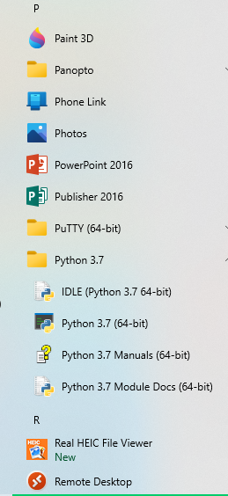
Programming environment for writing Python programs
When we install Python from the standard Python web page https://www.python.org, we will get a programming environment called IDLE.
IDLE allows you to run a Python program in two modes: script mode and interactive mode.
But, the interactive mode is not so useful
For this course, we will use Jupyter Notebook, which allows us to run a Python program between script mode and interactive mode.

Slide 12

Jupyter Notebook
In 2014, Fernando Pérez initiated a project called Project Jupyter.
The project has eventually developed and supported the interactive computing product Jupyter Notebook, which faciliates execution environments for many popular languages including Julia, Python, and R. We will focus on Ptyhon
A Jupyter Notebook contains an ordered list of input/output cells which can contain code, text, mathematics and figures. (It’s more than a program.)

Slide 13
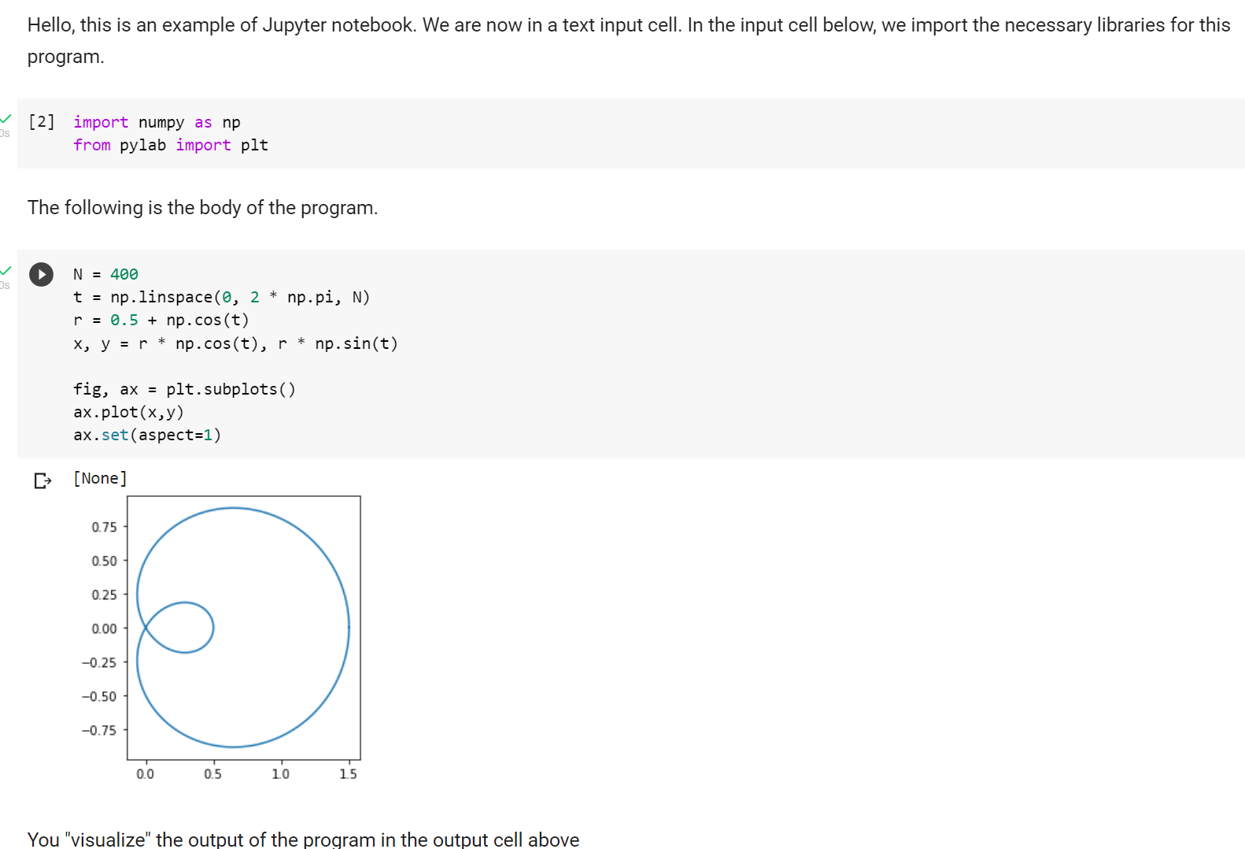
An example

Slide 14
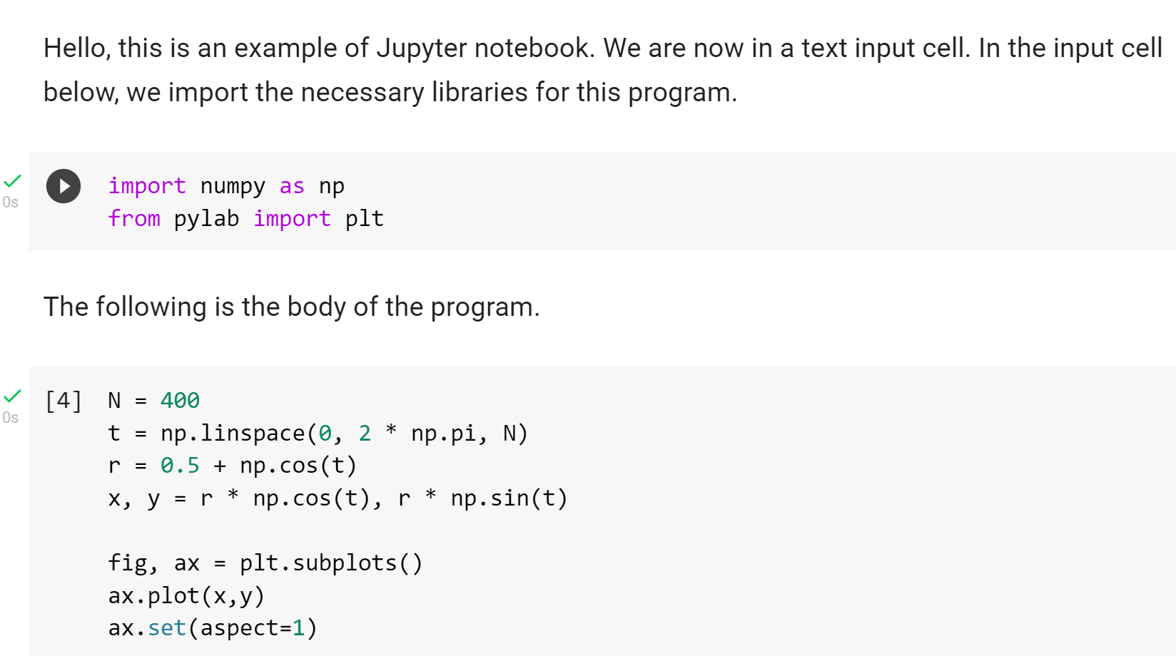
An example (Zoom in)
text input
cell
code input
cell

Slide 15
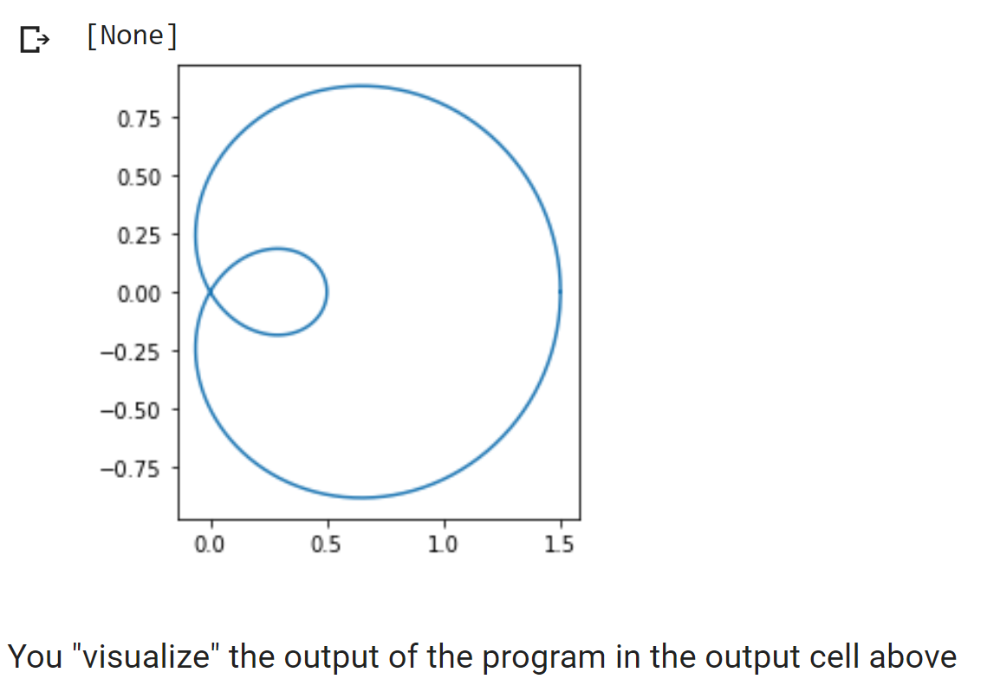
An example
output
cell

Slide 16
Writing Python program interactively
An input cell allows us to type in some fragment of Python codes, and then execute these fragment of codes (based on current set of variables created and updated by previous cells) and examine its output immediately in the output cell. This enables us to develop Python programs interactively.

Slide 17
How to write program interactively in a Jupyter Notebook
We focus on some small part of the program, input its codes in an input cell.
Then we execute this particular cell and examine its output in the output cell.
If we don’t like it, we make some changes in this cell (while keep the other part of program intact), and try again.
After being satisfied by the code in this cell, we open a new input cell to type in and test another fragment of codes.

Slide 18
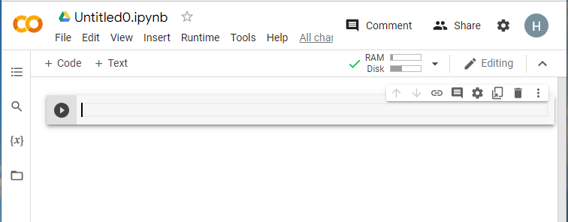
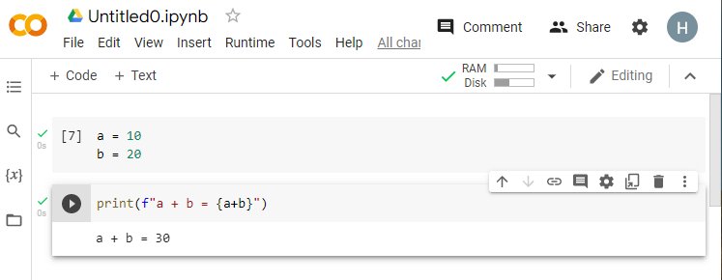
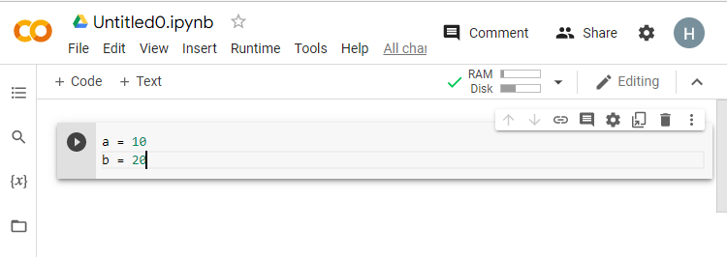
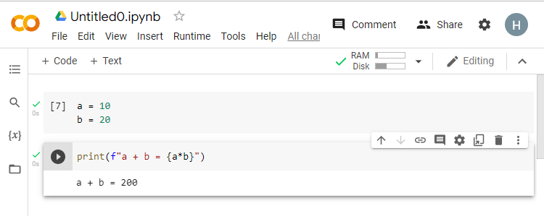
An example
An example:
find something wrong, and correct
the 2nd cell, and execute it:
Key: we don’t need to re-execute
the first cell
An empty notebook
input and exec
the first cell
input and exec
the 2nd cell

Slide 19
An example
Observe: A Jupyter notebook has extension .jpynb, not .py
An example:
find something wrong, and correct
the 2nd cell, and execute it:
Key: we don’t need to re-execute
the first cell
An empty notebook
input and exec
the first cell
input and exec
the 2nd cell

Slide 20
Why the extension ipynb
Recall that Jupyter also supports the programming R and the programming language Julia.
For each of the programming language, we need a backend (or engine, shell, or kernel) to run programs in that language
Python: kernel called iPython
R: kernel call IRkernel
Julia: IJulia

Slide 21
Another important property of Jupyter Notebook
Jupyter notebook is a web-based tool. You open and execute it using a Web browser.
Implication:
You can write your notebook in your local computer, but you open a Web browser (e.g., Microsoft Edge) locally to run the notebook.
You can also write and execute your programs on some remote servers on Internet.

Slide 22
To use Jupyter notebooks locally
You may install Anaconda , which is a free distribution of Python packages that helps us simplify package management and deployment
There are more than 20,000 Python packages (libraries) in the world. This amazing array of libraries and applications covering every use case imaginable. However, when it comes to installing and using these packages, users often find themselves running into issues with missing permissions, incompatible library dependencies, and installations that break in surprising ways. Anaconda helps solve these problems.

Slide 23
Anaconda
Anaconda has pre-installed around 250 useful and popular packages (i.e., software tools).
But you need to install the other libraries yourself. You may need some existing package manager like pip, which helps us check if the package is already installed, or if it needs to be updated, to control dependencies, or to assess whether other packages are necessary (e.g. the package pandas uses a lot of functions defined in another package numpy, and thus to use pandas, you need to install numpy too).

Slide 24
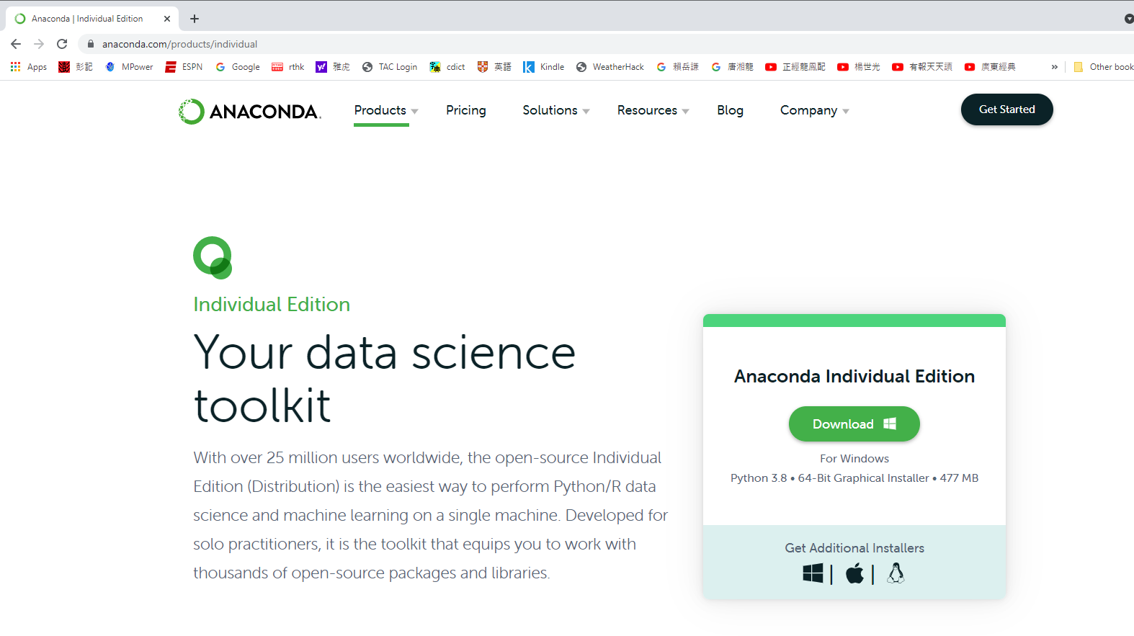
Installing Anaconda via https://www.anaconda.com/products/individual

Slide 25
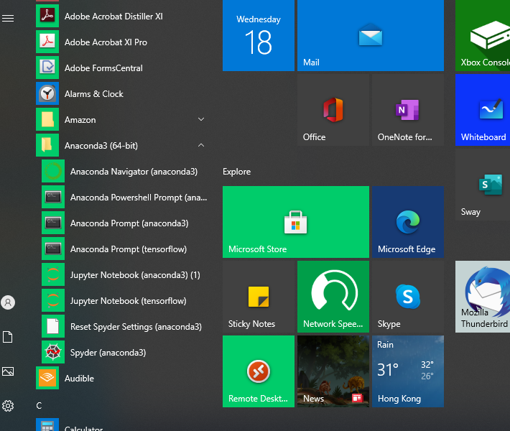
After installing Anaconda

Slide 26
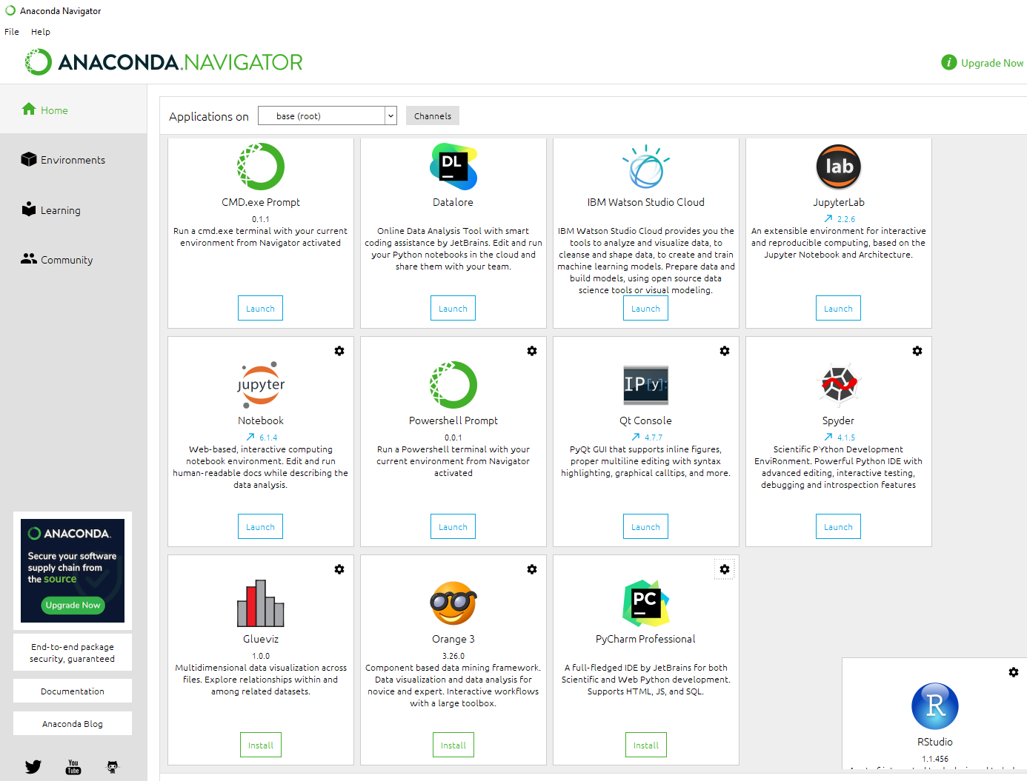
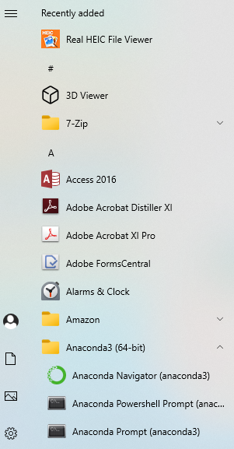
An example on using Anaconda

Slide 27
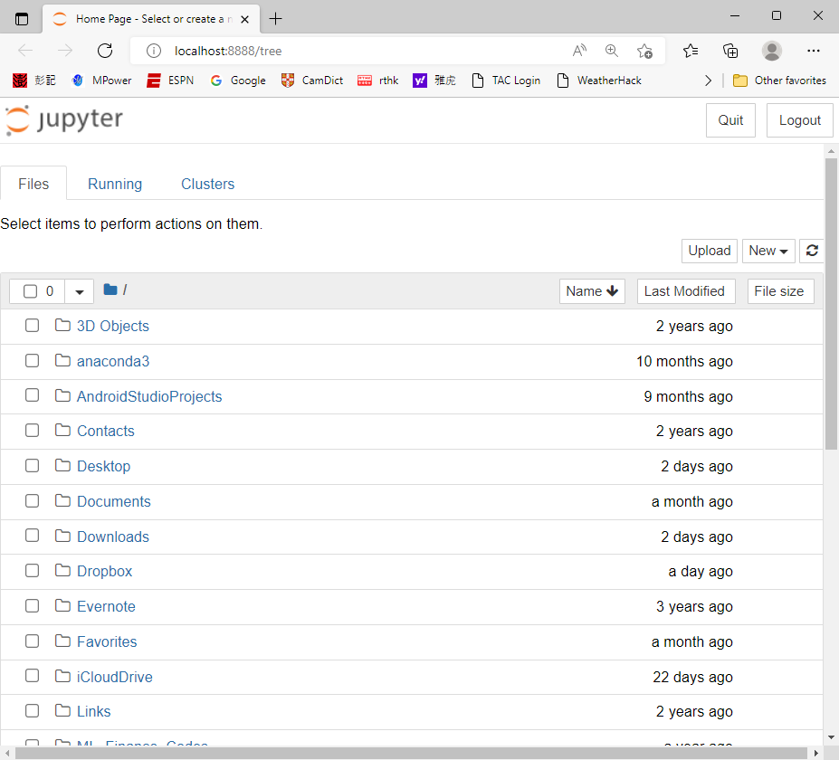
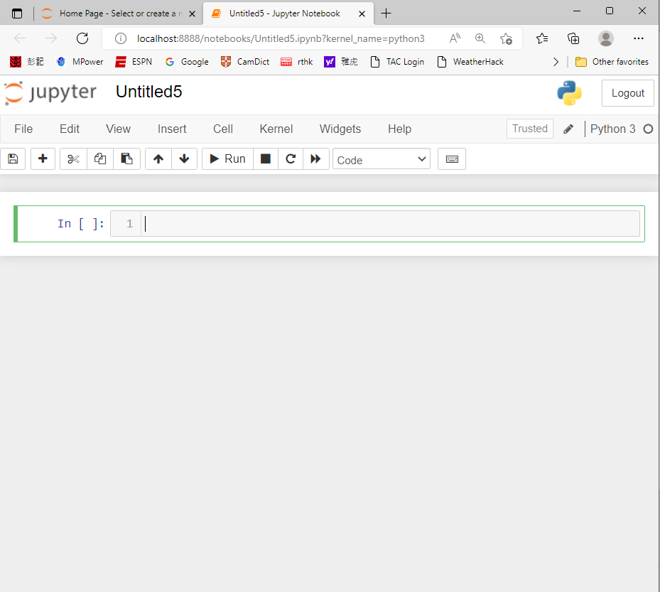

Slide 28
To run Jupyter notebooks remotely
In the last few years, Google’s Colaboratory (Colab) becomes one of the most popular cloud platform for data scientists to develop data science applications and perform data analytics.
Colab supports an convenient environment that allows us to store our Jupyter notebooks on Google Drive, and execute them using Google’s cloud server.
You don’t need to worry about the installation of most packages as you run your programs in its cloud, though for some special ones, you still need to install it using pip.

Slide 29


How to use Colab?
1. Sign in your Google account

Slide 30

2. Open google drive

Slide 31
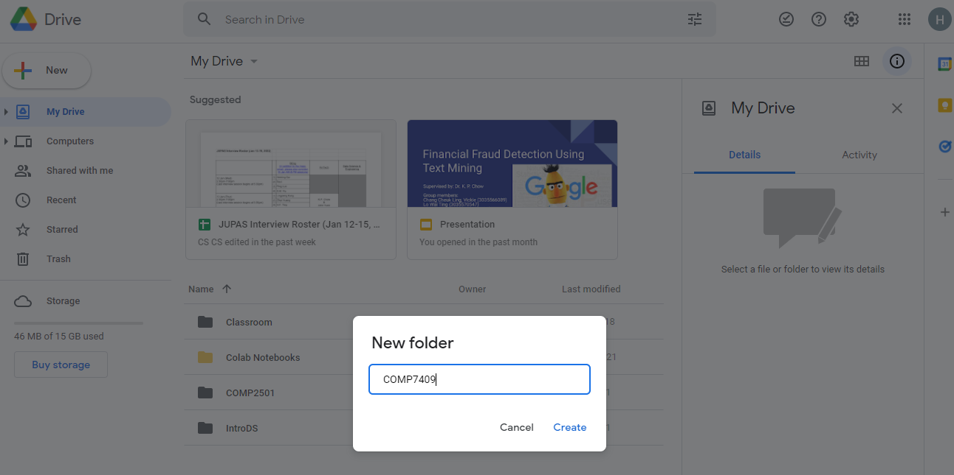
3. Create a folder

Slide 32
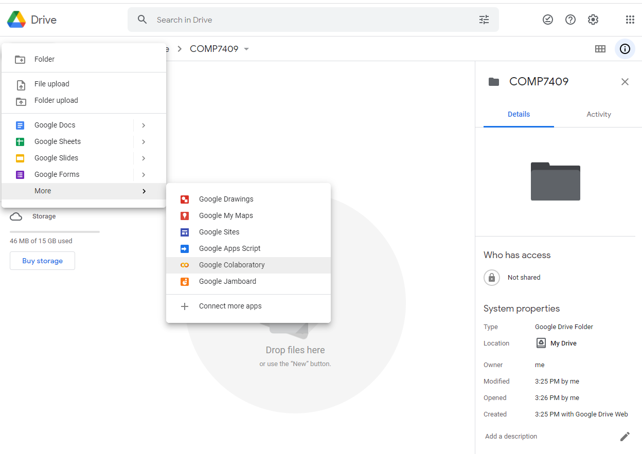
4. Move to that folder, and create a new “Colab” page

Slide 33
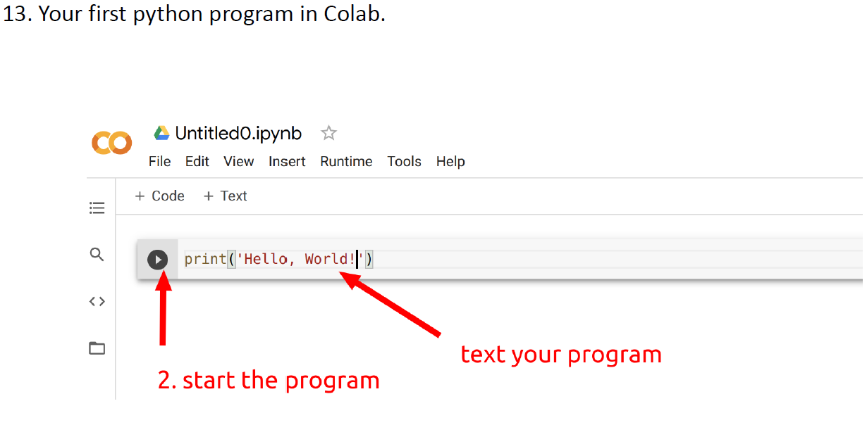
4. You can input your program now

Slide 34
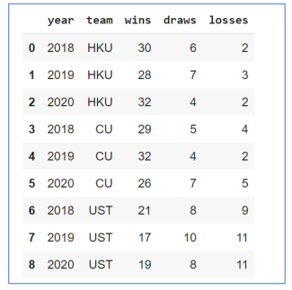
Try typing and executing the following program using Colab
Purpose: To create a Pandas table.
import pandas as pd
data = {'year': [2018, 2019, 2020,
2018, 2019, 2020,
2018, 2019, 2020],
'team': ['HKU', 'HKU', 'HKU',
'CU', 'CU', 'CU',
'UST', 'UST', 'UST'],
'wins': [30, 28, 32, 29, 32, 26, 21, 17, 19],
'draws': [6, 7, 4, 5, 4, 7, 8, 10, 8],
'losses': [2, 3, 2, 4, 2, 5, 9, 11, 11]
}
football = pd.DataFrame(data)
football
Output:

Slide 35
Background knowledge
We need enough knowledge and skill in Data Science (DS) and Machine learning (ML).
We will cover in the following slides some basics of DS, and in Lecture note # 2, we will cover ML basics.
We will use Google’s Colab to develop our programs.
Important: You need to know how to program in Python. This course will not teach Python.

Slide 36
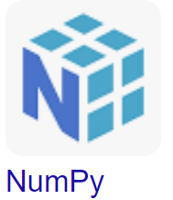
Very brief introduction on NumPy
At the dawn of the Python language, developers needed to perform numerical calculations, especially when this language was being used in scientific community.
Jim Hungunin developed the package Numeric in 1995 for numeric computation, and later developed another package called Numarray.
In 2006 Travis Oliphant developed the NumPy library, which unifying the two packages.
NumPy supports a wide range of functions that allow us to perform operations on arrays in a highly efficient way.

Slide 37
Very brief introduction on NumPy
Two important features of NumPy:
Major data structures: Ndarray, i.e, Multidimensional array. A 1-D array is like a list of numbers in Python, but you will see later that the two are very different. A 2-D array corresponds to a table. We will not work on 3-D, or even higher dimensional array.
Element-wise computation: NumPy provides a set of functions for performing element-wise computation with arrays and mathematical operations between arrays. (More details about element-wise computation will be given a few slides later.)

Slide 38
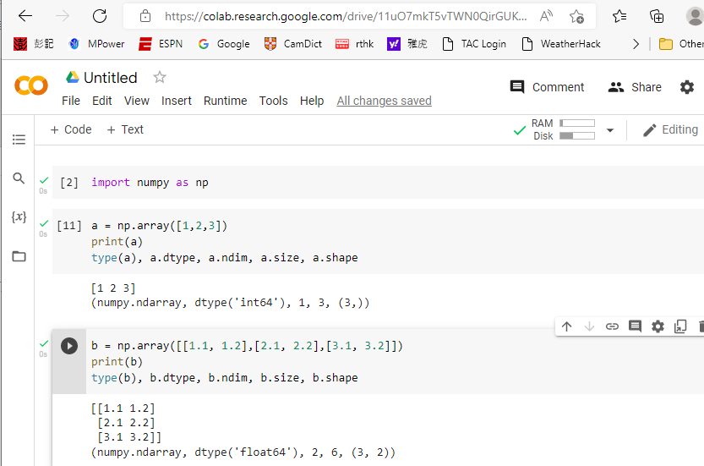
Some basic functions

Slide 39
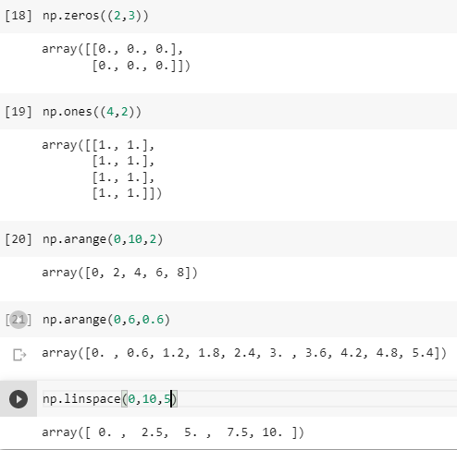
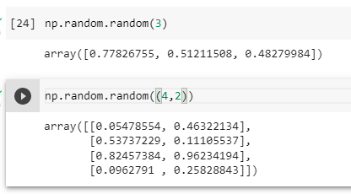
Simple ways to initialize an ndarray

Slide 40
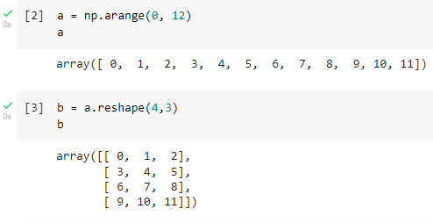
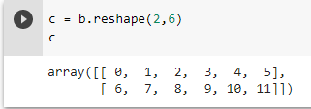
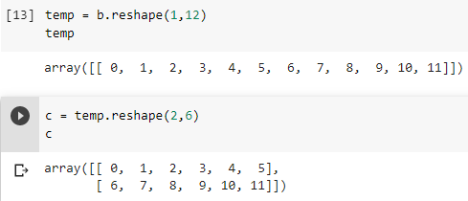
Constructing a 2-D (or even higher dimension) by “reshaping” a 1-D array.
=

Slide 41
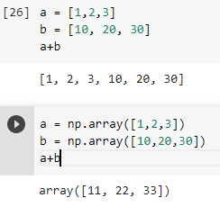
Element-wise operations
An ndarray is very different from the standard Python list:

Slide 42
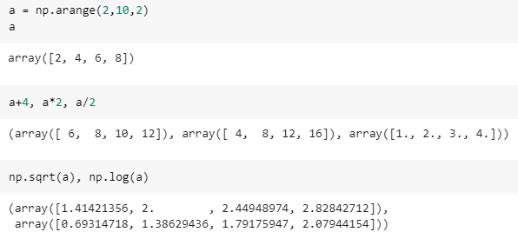
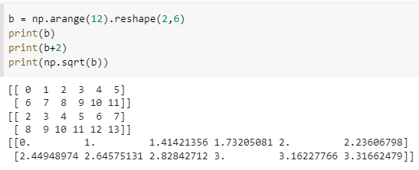
More functions

Slide 43
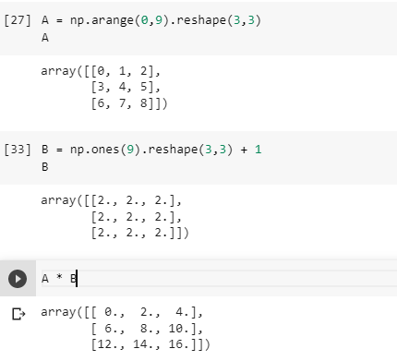
Operations on 2-D ndarray

Slide 44
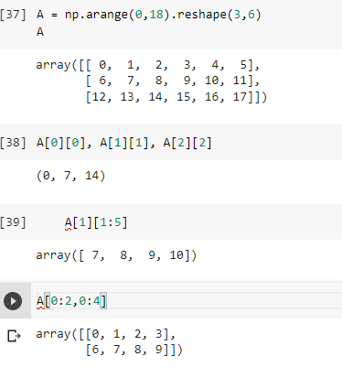
Indexing and slicing an ndarray
Just like a Python list, we can access an ndarray by indexing or by slicing.

Slide 45
Indexing and slicing an ndarray
Positive and Negative indices
We can access any specific element in an ndarray by its positive index p and its negative index n
Relationship between n and p: p = n + len(a)
a[3] = a[-6] = 4.4
a
1.1 | 2.2 | 3.3 | 4.4 | 5.5 | 6.6 | 7.7 | 8.8 | 9.9
0 | 1 | 2 | 3 | 4 | 5 | 6 | 7 | 8
-9 | -8 | -7 | -6 | -5 | -4 | -3 | -2 | -1

Slide 46
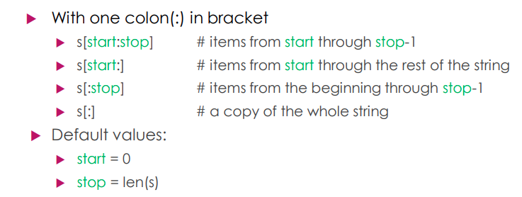
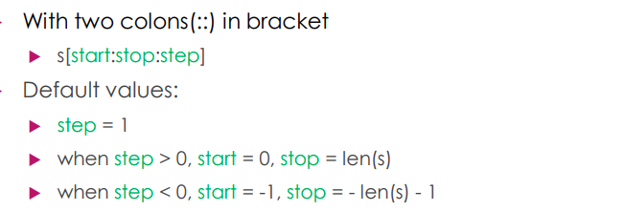
Indexing and slicing an ndarray
a
Default values in a slice a[start:stop:step] or a[start:stop]
1.1 | 2.2 | 3.3 | 4.4 | 5.5 | 6.6 | 7.7 | 8.8 | 9.9
0 | 1 | 2 | 3 | 4 | 5 | 6 | 7 | 8
-9 | -8 | -7 | -6 | -5 | -4 | -3 | -2 | -1

Slide 47
Indexing and slicing an ndarray
a
Default values in a slice a[start:stop:step] or a[start:stop]
1.1 | 2.2 | 3.3 | 4.4 | 5.5 | 6.6 | 7.7 | 8.8 | 9.9
0 | 1 | 2 | 3 | 4 | 5 | 6 | 7 | 8
-9 | -8 | -7 | -6 | -5 | -4 | -3 | -2 | -1
Exercises:
a[::-1]
a[1::-1]
a[-3:-1]
a[-2:]
a[:-2]

Slide 48
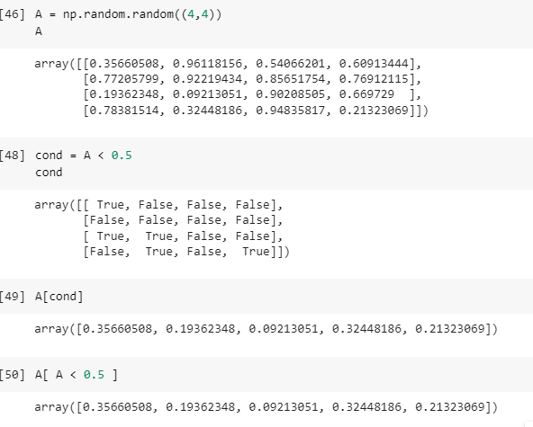
Conditions, Boolean Arrays and Selection

Slide 49

Very brief introduction of Pandas
Pandas: A powerful Python Data Analysis Library
The library was designed and developed primarily by Wes McKinney starting in 2008. In 2012, Sien Chang, one of his colleagues, was added to the development. Together they set up one of the most used libraries in the Python community.
Pandas supports two major data structures:
Series: Similar to Numpy’s 1D-array
Dataframes: A 2D table

Slide 50
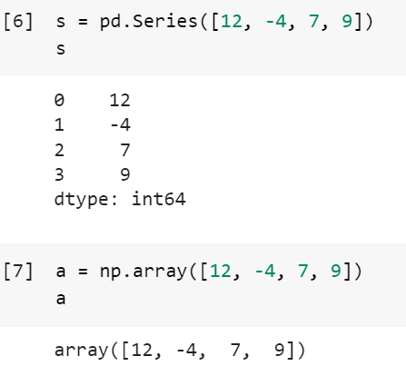
Series

Slide 51
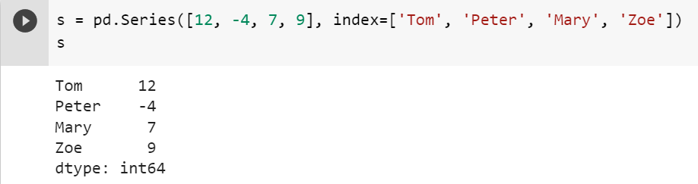
Series
values of the series
you can give your own index labels
index labels; by default,
they are equal to the
usual indexes we use to
access the elements in
a list, i.e., 0, 1,…,len-1.

Slide 52
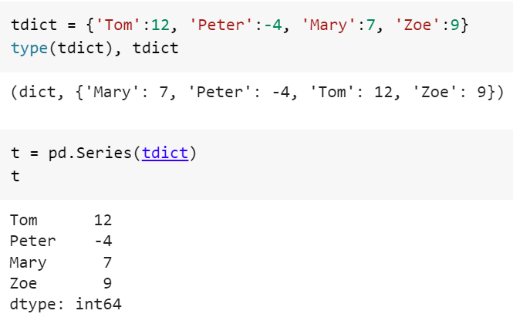
Series
You may create a series using Python dictionary

Slide 53
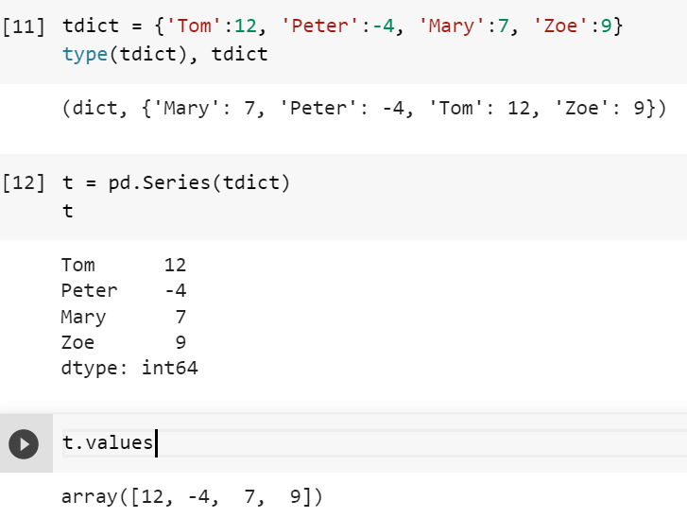
Relationship between pandas Series and numpy ndarray

Slide 54
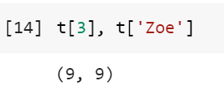
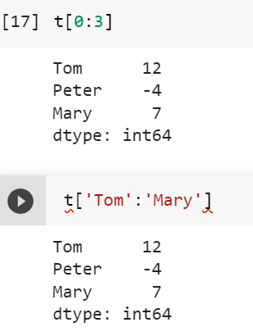
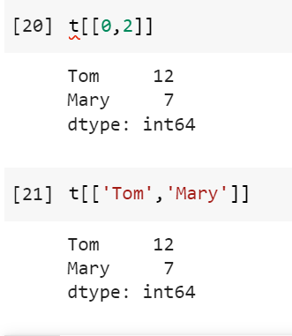
Relationship between pandas Series and numpy ndarray
Thus, we have two ways to access the
elements of a Series:
using the index as if it is a numpy
array; or
(2) using the series’s index labels

Slide 55
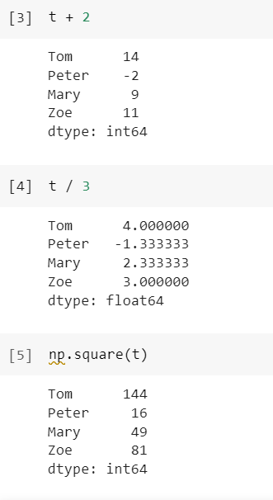
Relationship between pandas Series and numpy ndarray
Another implication: Elements-wise operations
can be applied to Series

Slide 56
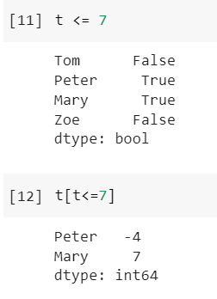
Relationship between pandas Series and numpy ndarray
Yet another implication: Conditions, Boolean array
and selection

Slide 57
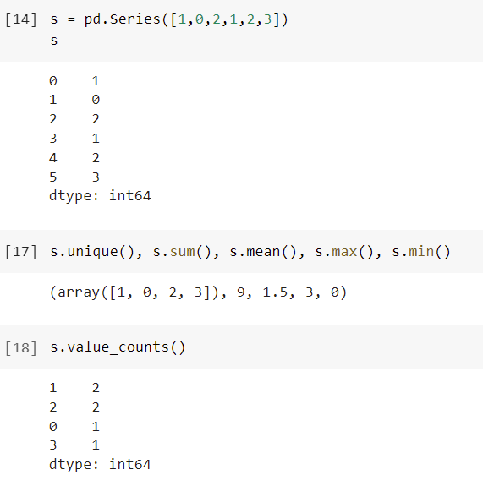
Some useful functions on Series

Slide 58
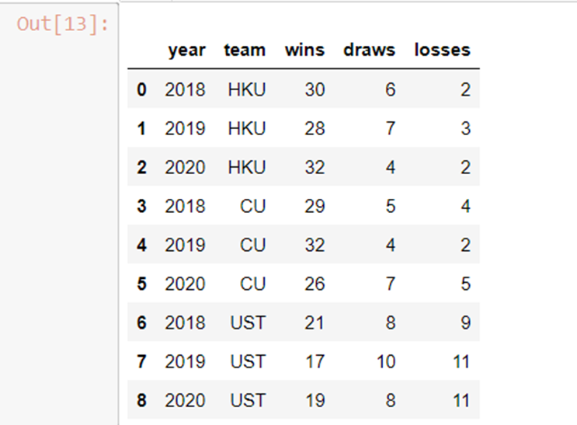
Next: DataFrames
Pandas’ DataFrame can be seen as an excel spreadsheet which offers very flexible ways of working with it.
...
Column
names
.
.
.
Row labels

Slide 59
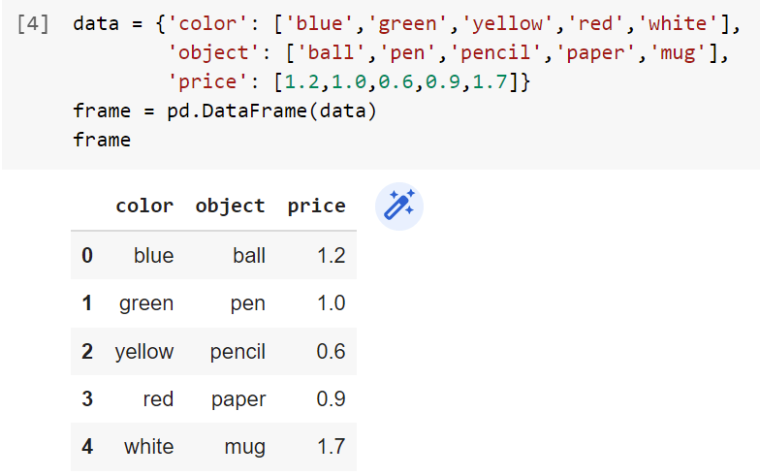
Creating a DataFrame

Slide 60
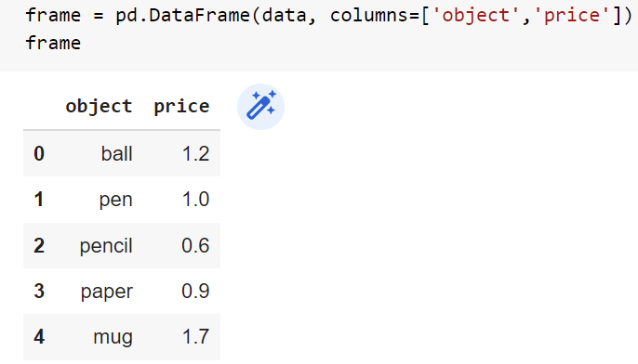
Creating a DataFrame
Sometimes, the dictionary contains many
columns that are not useful, and we can
select explicitly useful columns to
create the DataFrame

Slide 61
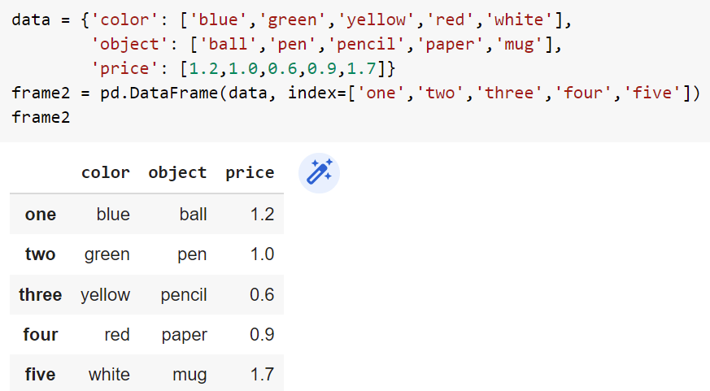
Creating a DataFrame
And of course we can give labels to the indexes.

Slide 62
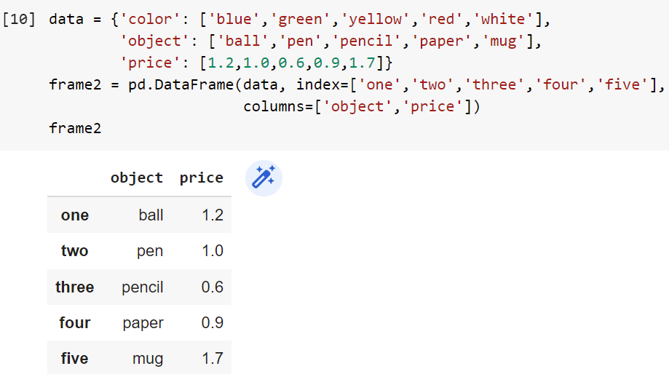
Creating a DataFrame
Assigning index labels and selecting columns at the same time:

Slide 63
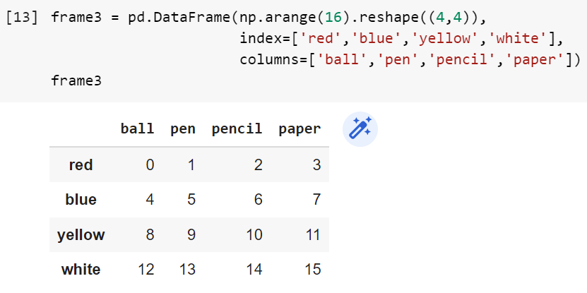
Creating a DataFrame
In addition to dictionary, there are many other ways to create a dataframe, e.g., list of lists, 2D numpy arrays, …

Slide 64


Creating a DataFrame
Creating a dataframe from a list of lists

Slide 65


Some functions for information

Slide 66


Some statistical functions

Slide 67

Some statistical functions

Slide 68



Selecting rows by index
recall the Python’s slicing operator:
0:3 ➔ [0,1,2]
Note: iloc is for selecting by index, and
loc is for selecting by label.

Slide 69
Reading and writing files
Most of public data are delivered in plain text format, excel format, CSV (comma-separated- value) format, or any other delimiter-separated value format.
Pandas provides many methods for reading these files, e.g., read_csv(), read_excel(), read_table(), read_clipboard();
and methods for writing these files, e.g., to_csv(), to_excel, to_table(), ...

Slide 70

An example
for
missing values

Slide 71

Not a Number
Pandas has
many methods
to deal with
this value

Slide 72
Some complication: We cannot access local file from Colab directly
There are several ways to solve this problem:
Store the files on Google Drive. But you need to go through a rather complicated authentication steps before you can access these files.
Store the files on GitHub.
The simplest way: store the files in our local computers, and upload them by calling files.upload() when we need them.
Followings are the details.

Slide 73

Reading a text file using “open()

Slide 74

Upload csv files

Slide 75

To download a csv file

